Slide 1
3 : Data Modeling using the
Entity-Relationship Model (6 Hrs)
Using High Level Conceptual Data Models for Database Design;
Entity Types, Entity Sets, Attributes, and keys; Relationship Types, Relationship Sets, Roles and Structure Constraints;
Weak Entity Types; ER Diagrams, Naming Conventions and Design Issues; Relationship Types of degree higher than two;
Subclasses, Superclasses and Inheritance; Specialization and Generalization; Constraints and Characteristics of Specialization and Generalization

Slide 2
Introduction
Conceptual modeling is a very important phase in designing a successful database applications.
Generally, the term database application refers to a particular database and the associated programs that implement the database queries and updates
These programs would provide user friendly graphical user friendly graphical user interface utilizing forms and menus for end users of the applications.
The design of application programs is part of software engineering.

Slide 3
Introduction
The entity-relationship (E-R) model is a high-level data model based on the perception of a real world that consists of a collection of basic objects, called entities and relationships among these entities.
An entity is a thing or object in the real world that is distinguishable from other objects.
A relationship is an association among several entities.
Entities are described by a set of attributes.
The set of all entities of the same type is called an entity set and the set of all relationships of the same type is called a relationship set.
In this model, we use E-R diagrams to express overall logical structure of the database.

Slide 4
Basic Concepts
The E-R model employs three basic notations: entity sets, relationship sets, and attributes.
Entity Sets:
  An entity is a thing or object in the real world that is distinguishable from all other objects. For example, specific person, company, event, plant etc.
  An entity has a set of properties called attributes, and the values for some set of properties may uniquely identify an entity. For example, people have names and addresses as attributes.
  An entity type defines a collection (or set) of entities that have the same properties, or attributes. For example, set of all persons, companies, trees, holidays etc.

Slide 5
Basic Concepts
The collection of all entities of a particular entity type in the database at any point in time is called entity set,
The entity set is usually referred to using the same name as the entity type.
For example, EMPLOYEE refers to both a type of entity as well as the current set of all employees entities in the database.
An entity type is represented in ER diagrams as a rectangular box enclosing the entity type name.
Attribute names are enclosed in ovals and are attached to their entity type by straight lines.

Slide 6
Basic Concepts
Composite attributes are attached to their component attributes by straight lines.
Multivalued attributes are displayed in double ovals.
An entity type describes the schema or intension for a set of entities that share the same structure.

Slide 7
Basic Concepts
Key Attributes of an Entity Type: An important constraint on the entities of an entity is the key or uniqueness constraint on attributes.
An entity type usually has one or more attributes whose values are distinct for each individual entity in the entity set. Such as attribute is called a key attribute.
For example, Name attribute is a key attribute of the COMPANY entity type because no two companies are allowed to have the same name.
For the PERSON entity type, a typical key attribute is ssn (social security number). This attribute is underlined inside the oval.

Slide 8
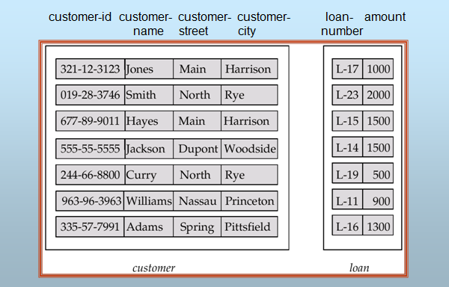
Basic Concepts
Fig: Entity sets customer and loan

Slide 9
Basic Concepts
Attributes:
  An entity is represented by a set of attributes. For example, a customer entity can have customer-id, customer-name, customer-street, and customer-city as attributes.
  Attributes are the descriptive properties possessed by all members of an entity set. Each entity may have its own value for each attribute.
  For each attribute, there is a set of permitted values, called the domain or value set of that attribute.
  The E-R model uses the different types of attributes.
  Simple and Composite Attributes:
    Simple attributes cannot be divided into subparts. For example, gender.
    Composite attributes on the other hand can be divided into subparts; that is, other attributes. A composite attribute may appear as hierarchy. For example, name, address etc.

Slide 10

Basic Concepts
Fig: Composite attributes

Slide 11
Basic Concepts
  Single-valued and Multi-valued Attributes:
    An attribute having a single value for a particular entity is called the single-valued attribute. For example, gender.
    An attribute having a set of values for a particular entity is called the multi-valued attribute. For example, phone-numbers.
  Derived Attributes:
    The value of the derived attributes can be computed from other attributes. For example, age, given date-of-birth.
  All attributes take a null value when an entity does not have a value for it. The null value may indicate “not applicable”, that is, the value does not exist for the entity.

Slide 12
Basic Concepts
Relationship Sets:
  A relationship is an association among several entities.
  A relationship set is a set of relationships of the same type.
  Formally, it is a mathematical relation on n ≥ 2 entity sets. If E₁, E₂,…, E_{n} are entity sets, then a relationship set R is a subset of {(e₁, e₂,…, e_{n})|e₁∈E₁, e₂∈E₂,…, e_{n}∈E_{n}}, where (e₁, e₂,….., e_{n}) is a relationship. For example, (Hayes, L-15) ∈ borrower relationship set.
  The association between entity sets is referred to as participation, that is, the entity sets E₁, E₂,…., E_{n} participate in relationship set R.
  A relationship instance represents an association between the named entities.

Slide 13
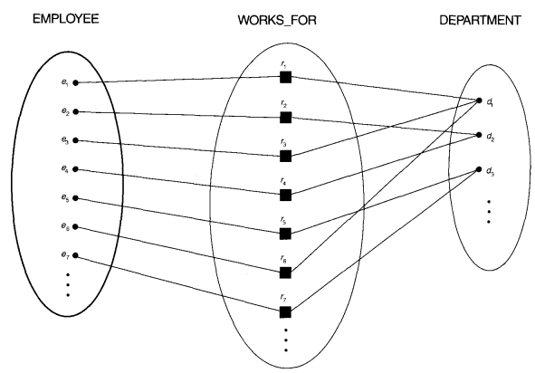
Figure: Some instances in WORKS_FOR relationship set, which represents relationship type WORKS_FOR between EMPLOYEE and DEPARTMENT

Slide 14

Basic Concepts
Fig: Relationship set borrower

Slide 15
Attributes of Relationship Type
  A relationship types can also have attributes, similar to those of entity types. for example, to record the number of hours per week that a particular employee works on a particular project, we can include an attribute Hours for WORKS_ON relationship type (next slide).
  The attributes of 1:1 relationship type can be migrated to one of the participating entity type.
  For a 1:N relationship type, a relationship attribute can be migrated to only to the entity type on the N side of the relationship
  For N:M relationship types, some attributes may be determined by the combination of participating entities in a relationship instance, not only any single entity. Such attributes may be specified as relationship attributes. An example is the Hours attribute of the M:N relationship WORKS_ON(slide 13); the number of hours per week an employee currently works on a project is determined by an employee-project combination and not separately by either entity.

Slide 16

Basic Concepts
Fig: Descriptive attribute

Slide 17
Basic Concepts
  There can be more than one relationship set involving the same entity set.
  Degree of a relationship set refers to the number of entity sets that participate in a relationship set.
  Relationship sets that involve two entity sets are called binary relationship sets. Most relationship sets in a database system are binary.
  Relationship sets may involve more than two entity sets called n-ary relationship sets but are rare. For example, suppose employees of a bank may have jobs (responsibilities) at multiple branches, with different jobs at different branches. Then there is a ternary relationship set between entity sets employee, job and branch.

Slide 18
Role Names and Recursive Relationships
  Each entity type that participates in a relationship type plays a particular role in the relationship.
  The function that an entity plays in a relationship is called that entity’s role.
  The role name signifies the role that a particular entity from the entity type plays in each relationship instance, and helps to explain what the relationship means.
  In case of distinct entity sets participating in a relationship set, roles are implicit and are not usually specified.
  When the entity sets of a relationship set are not distinct; that is, the same entity set participates in a relationship set more than once, in different roles, explicit role names are necessary to specify how an entity participates in a relationship instance.
  This type of relationship set is sometimes called a recursive relationship set or self-referencing referencing relationships

Slide 19
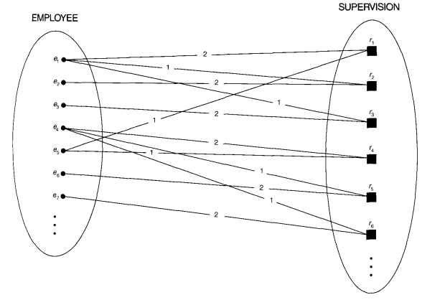
Role Names and Recursive Relationships
Figure: A recursive relationship SUPERSION
between EMPLOYEE in the supervisor role (1)
And EMPLOYEE in the subordinate role(2)

Slide 20
Constraints on Binary Relationship Types
Relationship types usually have certain constraints that limit the possible combinations of entities that may participate in the corresponding relationship set.
These constraints are determined from the miniworld situation that the relationships represent. For example, if the company has a rule that each employee must work for exactly one department, then we would like to describe this constraint in the schema.
We can distinguish two main types of binary relationship constraints: cardinality ratio and participation constraints

Slide 21
Cardinality Ratios for Binary Relationships
Mapping Cardinalities: The cardinality ratio for a binary relationship specifies the maximum number of relationship instances that an entity can participate.
For example, in the WORKS_FOR binary relationship type, DEPARTMENT:EMPLOYEE is of cardinality ratio 1:N, meaning that each department can be related any number of employee (N)
  For binary relationship set R between entity sets A and B, there are four types of mapping cardinalities: one-to-one, one-to-many, many-to-one, and many-to-many.
  One to One: An entity in A is associated with at most one entity in B, and an entity in B is associated with at most one entity in A. For example, mapping cardinality between departments and chairpersons.

Slide 22
Constraints
  One to Many: An entity in A is associated with any number (zero or more) of entities in B. an entity in B, however, can be associated with at most one entity in A. For example, mapping cardinality between mothers and children.
  Many to One: An entity in A is associated with at most one entity in B. an entity in B, however, can be associated with any number (zero or more) of entities in A. For example, mapping cardinality between children and mothers.
  Many to Many: An entity in A is associated with any number (zero or more) of entities in B, and an entity in B is associated with any number (zero or more) of entities in A. For example, mapping cardinality between students and courses.

Slide 23
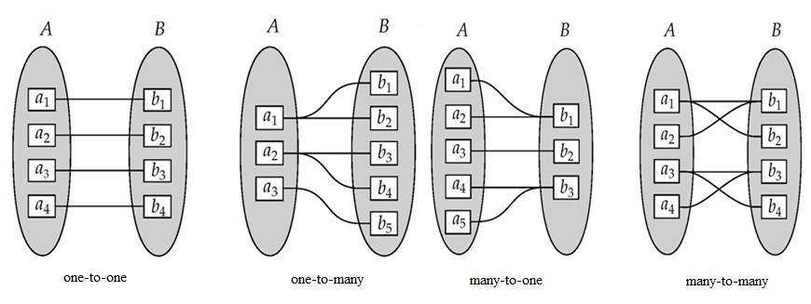
Constraints

Slide 24
Constraints
Participation Constraints:
  The participation of an entity set A in a relationship set R is said to be total if every entity in A participates in at least one relationship in R. For example, consider customer and account entity sets in a banking system, and a relationship set depositor between them indicating that each customer must have an account. Then there is total participation of entity set customer in the relationship set depositor.
  If only some entities in A participate in relationships in R, the participation of entity set A in relationship set R is said to be partial. For example, consider customer and loan entity sets in a banking system, and a relationship set borrower between them indicating that some customers have loans. Then there is partial participation of entity set customer in the relationship set borrower.

Slide 25
Keys
Keys are used to distinguish the entities within a given entity set. Furthermore, a key allows us to identify a set of attributes that suffice to distinguish entities from each other. Keys also help to uniquely identify relationships.
Keys for Entity Sets:
  A super-key of an entity set is a set of one or more attributes whose values uniquely determine each entity. Any superset of a super-key is also a super-key.
  A super-key may also contain extraneous attributes. A candidate key of an entity set is a minimal super-key; that is, super-key for which no proper subset is a super-key. For example, customer-id is candidate key of customer entity set.
  An entity set may have several candidate keys. We use the term primary key to denote a candidate key that is chosen by the database designer for identifying entities within an entity set.

Slide 26
Keys
  Alternate keys are the remaining candidate keys other than primary key.
  So, there is always one and only one primary key in an entity set. A primary key of an entity set allows us to distinguish among various entities of the set.
Keys for Relationship Sets:
  The combination of primary keys of the participating entity sets forms a super-key for the relationship set. For example, (customer-id, account-number) is the super key of depositor relationship set.
  Let R be a relationship set involving entities E₁, E₂,……, E_{n}. Let primary-key (E_{i}) denotes the set of attributes that forms the primary key for entity set E_{i}. Assume that the attribute names of all primary keys are unique, and each entity set participates only once in the relationship. The super key for the relationship set can be defined as
  primary-key (E₁)U primary-key (E₂)U……U primary-key (E_{n})

Slide 27
Entity-Relationship Diagram
An E-R diagram expresses the overall logical structure of a database graphically. E-R diagram consists of the following major components:
  Rectangles represent entity sets.
  Diamonds represent relationship sets.
  Lines link attributes to entity sets and entity sets to relationship sets.
  Ellipses represent attributes
  Double ellipses represent multi-valued attributes.
  Dashed ellipses denote derived attributes.
  Underline indicates primary key attributes
  Double Lines indicate total participation of an entity set in a relationship set.
  Double Rectangles represent weak entity sets.
  Double Diamonds represent identifying relationship sets.

Slide 28

Entity-Relationship Diagram
Fig: E-R diagram with composite, multivalued, and derived attributes

Slide 29

Entity-Relationship Diagram
Fig: E-R diagram corresponding to customers and loans
To distinguish the type of the relationships, we draw either a directed line (→) or an undirected line (⎯) between the relationship set and the entity set. Directed line indicates one and undirected line indicates many.
Hence, the figure above has many-to-many relationship.

Slide 30

Entity-Relationship Diagram
One-to-one relationship: Suppose a customer is associated with at most one loan and a loan is associated with at most one customer via the relationship set borrower.

Slide 31
Entity-Relationship Diagram
One-to-many relationship: Suppose a loan is associated with at most one customer and a customer is associated with several (including 0) loans via borrower relationship set.

Slide 32
Entity-Relationship Diagram
One-to-many relationship: Suppose a loan is associated with several (including 0) customers and a customer is associated with at most one loan via borrower relationship set.

Slide 33

Entity-Relationship Diagram
If a relationship set has also some attributes associated with it, then we link these attributes to that relationship set.

Slide 34

Entity-Relationship Diagram
We indicate roles in an E-R diagram by labeling the lines that connect diamonds to rectangles.

Slide 35

Entity-Relationship Diagram
Double lines are used to indicate that the participation of an entity set in a relationship set is total; that is, each entity in the entity set occurs in at least one relationship in that relationship set.

Slide 36

Entity-Relationship Diagram
E-R diagram also provide a way to indicate more complex constraints on the number of times each entity participates in relationships in a relationship set. An edge between an entity set and a binary relationship set can have an associated minimum and maximum cardinality, shown in the form of L….H, where L is the minimum and H is maximum cardinality.

Slide 37

Entity-Relationship Diagram
Non-binary relationship sets can also be specified easily in an E-R diagram.

Slide 38
Entity-Relationship Diagram
Weak entity set:
  An entity set may not have sufficient attributes to form a primary key. Such an entity set is termed as a weak entity set. An entity set that has a primary key is termed as a strong entity set.
  For a weak entity set to be meaningful, it must be associated with another entity set, called the identifying or owner entity set, using one of the key attribute of owner entity set. The weak entity set is said to be existence dependent on the identifying entity set. The relationship associating the weak entity set with the identifying entity set is called the identifying relationship. The identifying relationship is many-to-one form the weak entity set to the identifying entity set, and the participation of the weak entity set in the relationship set is total.
  Although a weak entity set does not have a primary key, we use discriminator (or partial key) as a set of attributes that allows the distinction to be made among all the entities in the weak entity set.

Slide 39

Entity-Relationship Diagram
  In the figure below, payment-number is partial key and (loan-number, payment-number) is primary key for payment entity set.

Slide 40
Proper Naming of Schema Constructs
When designing a database, the choice of names for entity types, attributes, relationship types and (particularly) roles is not straightforward.
One should choose names that convey, as much as possible, the meanings attached to the different constructs in the schema.
We choose to use singular names (CAPITAL) for entity types, rather than plural ones, because the entity type name applies to each individual entity belonging to that entity type.

Slide 41
Proper Naming of Schema Constructs
We use the convention that entity type and relationship type names are in uppercase letters, attribute names have their initial names have their initial letters capitalized, and role names are in lowercase letters.
We use nouns to give name to entity type and verbs to give names to relationship types.
Attribute names generally arise from additional nouns that describe the nouns corresponding to entity types.
Another naming consideration involves choosing binary relationship names to make the ER diagram of the schema readable from left to right and top to bottom

Slide 42
Choosing between Binary and Ternary (or Higher Degree) Relationships
In general, a ternary relationship type represents different information than do three binary relationship types.
The existence of three relationship instances does not necessarily imply that an instance exists in ternary relationship.
It is often tricky to decide whether a particular relationship should be represented as relationship type of degree n or should be broken down into several relationship types of smaller degrees.
The designer must base this decision on the semantics or meaning of the particular situation being represented.
The typical solution is to include the ternary relationship plus one or more of the binary relationships, if they represent different meanings and if all are needed by the application

Slide 43

1-<number>

Slide 44
Introduction to Extended E-R Model(EER Model)
As the complexity of data increases in the late 1980s, it became more and more difficult to the traditional ER Model for database modeling.
Hence some improvement or enhancements were made to the existing ER Model, along with other improvements were made to the existing ER Model to make it able to handle the complex applications better.
Hence, as part of the Enhanced ER model, along with other improvements, three new concepts were added to the existing ER Model, they were
Subclasses and Super Classes
Specialization and Generalization
Category or union type
Aggregation

Slide 45
EER(Extended ER) Modeling
It includes all of the modeling concepts of the ER model, in addition it includes the concepts of subclass and superclass and the related concepts of specialization and generalization.
Subclass and Superclass:
  An entity set may have a number of sub-groupings of its entities that are meaningful. Here, the entity set is called superclass while the subgroupings are known as subclasses of the superclass, that is, a subclass S is a class whose entities must always be a subset of the entities in another class, called superclass C.
  We call the relationship between a superclass and any one of its subclass a superlass /subclass or simply class/subclass relationship.
  An entity that is a member of subclass inherits all attributes from its superclass. That is, there is type inheritance in subclass. The entity also inherits all the relationships in which the superclass participates.

Slide 46
Subclasses, Super Classes and inheritance
Shape
super
d
Sub-classes
square
circle
triangle

Slide 47
EER(Extended ER Modeling)
Specialization:
  It is a top-down design process. Here, we define a set of subclasses of a given, superclass entity set.
  The set of sublcasses that form specialization is defined on the basis of some distinguishing characteristics of the entities in the superclass.
  Specialization is depicted by a triangle component labeled ISA. For example, customer “is a” person.
  The ISA relationship also referred to as superclass-subclass relationship.
  Here, a lower-level entity set inherits all the attributes and relationship participation of the higher-level entity set to which it is linked.
  The figure on the next slide shows specialization.

Slide 48

Fig: Specialization example

Slide 49
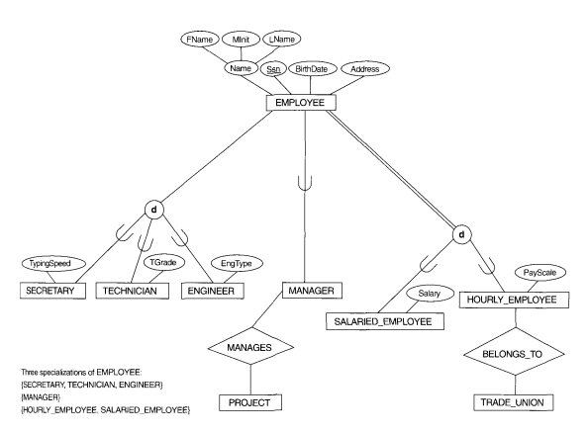
1-<number>

Slide 50
EER(Extended ER Modeling)
Generalization:
  It is a bottom-up design process. Here, we combine a number of entity sets that share the same features into a higher-level entity set.
  The original classes become the subclass of the newly formed generalized superclass.
  The reason, a designer applies generalization is to emphasize the similarities among the entity sets and hide their differences.
  Specialization and generalization are simple inversions of each other; they are represented in an E-R diagram in the same way.
  The terms specialization and generalization are used interchangeably.

Slide 51
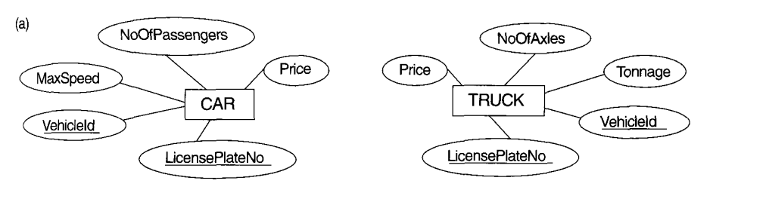
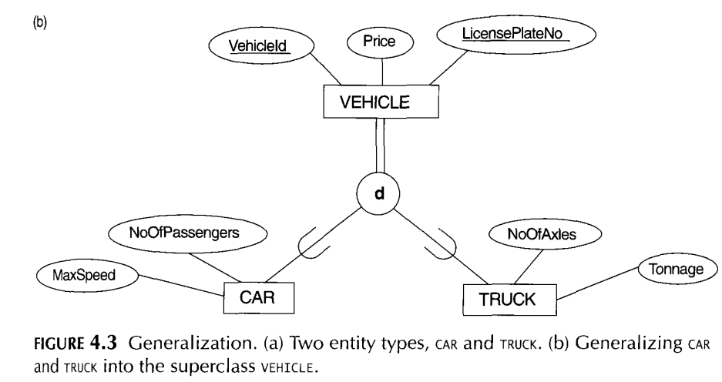

Slide 52
EER(Extended ER Modeling)
Design Constraints on Specialization/Generalization:
  Constraint on which entities can be members of a given lower-level entity set:
    Condition-defined: If we can determine exactly those entities that will become members of each subclass by a condition, the subclasses are called predicate-defined (or condition-defined) subclasses. Here, condition is a constraint that determines subclass members. For example, all customers over 65 years are members of senior-citizen entity set; senior-citizen ISA person.
    Attribute-defined: If all subclasses have membership condition on the same attribute of the superclass, it is called an attribute defined-subclass. And, the attribute is called the defining attribute.
    Example: JobType is the defining attribute of {SECRETARY, TECHNICIAN, ENGINEER} of EMPLOYEE.

Slide 53
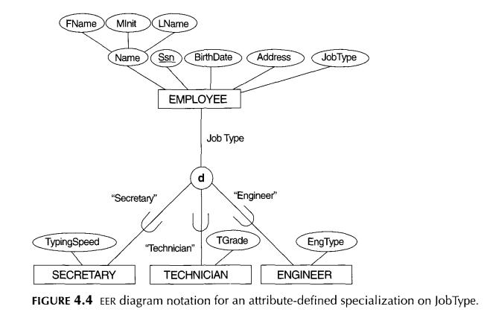
50

Slide 54
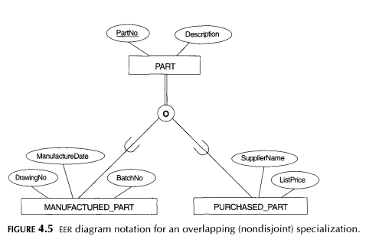

Slide 55
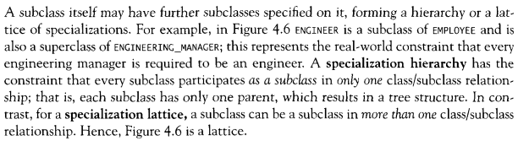
Specialization/Generalization Hierarchies and Lattices

Slide 56
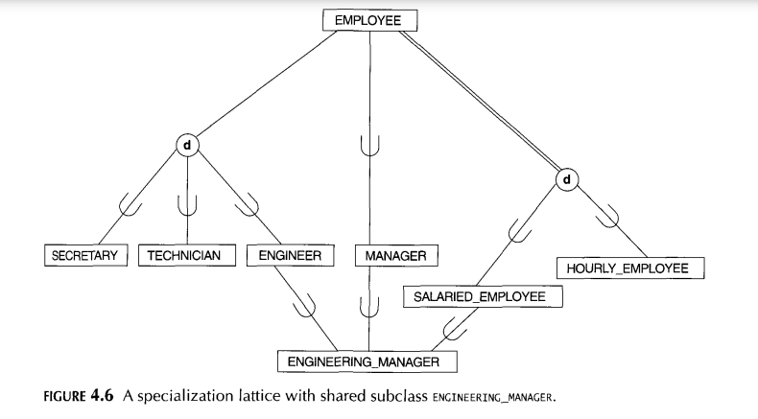

Slide 57
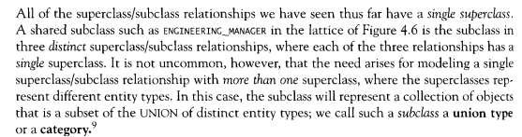
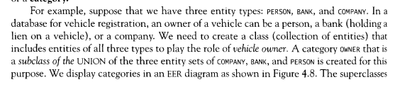
Modeling of Union Types Using Categories

Slide 58


Modeling of Union Types Using Categories

Slide 59
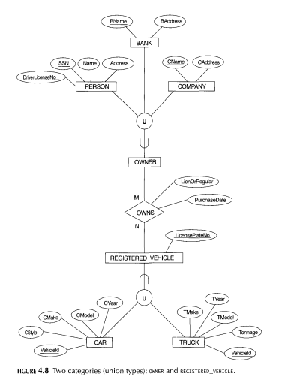

Slide 60

EER(Extended ER Modeling)
Aggregation
  Aggregation is an abstraction through which relationship sets are treated as high-level entity sets and can participate in relationship sets. Allows relationships between relationships.

Slide 61
EER(Extended ER Modeling)
    User-defined: If no condition determines membership, the subclass is called user-defined. Membership in a subclass is determined by the database users by applying an operation to add an entity to the subclass. Membership in the subclass is specified individually for each entity in the superclass by the user.
  Constraint on whether or not entities may belong to more than one lower-level entity set.
    Disjoint: An entity can belong to only one lower-level entity set. Noted in E-R diagram by writing disjoint next to the ISA triangle.
    Overlapping: An entity can belong to more than one lower-level entity set.
  Constraint that specifies whether or not an entity in the higher-level entity set must belong to at least one of the lower-level entity sets.
    Total : An entity must belong to one of the lower-level entity sets
    Partial: An entity need not belong to one of the lower-level entity sets.

Slide 62
EER(Extended ER Modeling)
Aggregation
  Aggregation is an abstraction through which relationship sets are treated as high-level entity sets and can participate in relationship sets.
  Allows relationships between relationships.

Slide 63

Summary of Symbols in ER Diagram

Slide 64
Summary of Symbols in ER Diagram

Slide 65

Alternative ER Notations

Slide 66
Design Issues
It is possible to define a set of entities and the relationships among them in a number of ways.
1. Use of Entity Sets versus Attributes: The choice of entity sets and attributes mainly depend on the structure of the real world enterprise being modeled, and on the semantics associated with the attribute in question. Some guidelines include:
  Do not use the primary key on an entity set as an attribute of another entity set, instead of using a relationship.
  Do not use the primary key attributes of the related entity sets as attributes of the relationship set.
2. Use of Entity Sets versus Relationship Sets: Possible guideline in determining whether to use an entity set or a relationship set is to designate a relationship set to describe an action that occurs between entities.

Slide 67
Design Issues
3. Binary versus n-ary Relationship Sets: Although it is possible to replace any nonbinary (n-ary, n>2) relationship set by a number of distinct binary relationship sets, a n-ary relationship set shows more clearly that several entities participate in a single relationship.
4. Placement of Relationship Attributes: The cardinality ratio of a relationship can affect the placement of relationship attributes. Thus, attributes of one-to-one or one-to-many relationship sets can be associated with one of the participating entity sets, rather than with the relationship set. Attributes of a one-to-many relationship set can be repositioned to only the entity set on the “many” side of the relationship. For one-to-one relationship sets, the relationship attribute can be associated with either one of the participating entity sets.

Slide 68

Example: ER Diagram for Banking Enterprise

Slide 69
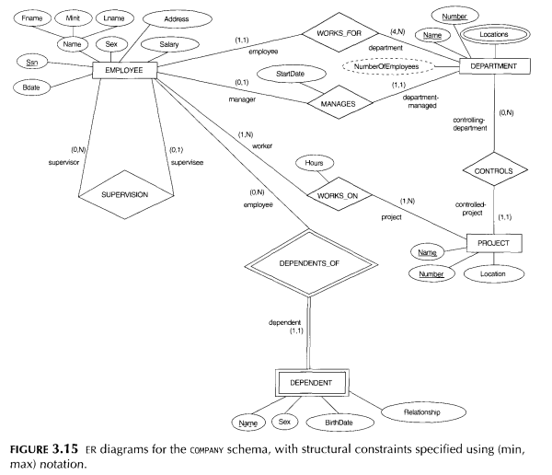
1-<number>

Slide 70
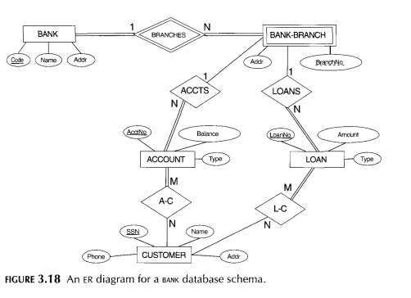
1-<number>

Slide 71
Exercises
Construct an ER diagram for a car-insurance company whose customers own one or more cars each. Each car has associated with it zero to any number of recorded accidents.
Construct an ER diagram for a hospital with a set of patients and a set of doctors. Associate with each patient a log of the various tests and examinations conducted.
Construct an ER diagram of the library system in your college.
Construct an ER diagram to maintain data about students, instructors, semester, and courses in a college.
Construct an ERD to record the marks that students get in different exams of different course offerings.

